Slide 1
Programming fundamentals
Lecture 24: Read/write to a file

Slide 2
Recap
Streams
Input/output stream
Intro to file handling
Why files?
Open a file
Different modes of opening a file
Opening a file for input
Opening a file for output (with trunc and append mode)
Close a file

Slide 3
Stream
C++ I/O occurs in streams, which are sequences of bytes.
In input operations, the bytes flow from a device (e.g., a keyboard, a disk drive, a network connection, etc.) to main memory.
In output operations, bytes flow from main memory to a device (e.g., a display screen, a printer, a disk drive, a network connection, etc.).
Input device
Program
Flow of bytes
Output device
Program
Flow of bytes

Slide 4
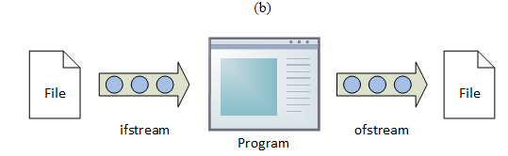
ifstream
Input File Stream. The "i" stands for input and the "f" stands for file; so, a stream object from which data may be read.
ofstream
Output File Stream. The "o" stands for output and the "f" stands for file; so, a stream object to which data may be written.
fstream
File Stream. The "f" stands for file but there is no indication of direction; so, a stream object that allows both reading and writing.

Slide 5
For both Input/output
For Input only
For Output only
#include<iostream>
#include<fstream>
using namespace std;
int main()
{
return 0;
}
#include<iostream>
#include<ifstream>
using namespace std;
int main()
{
return 0;
}
#include<iostream>
#include<ofstream>
using namespace std;
int main()
{
return 0;
}

Slide 6
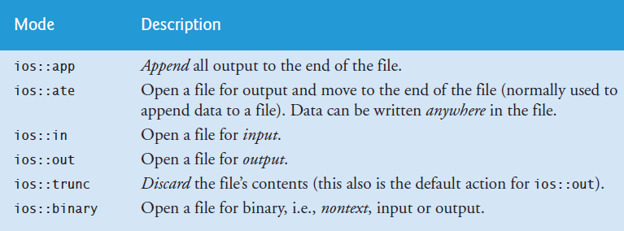
File modes

Slide 7
Opening a file for input

Slide 8
Open a file (using ifstream)
Two arguments are passed to the object’s constructor—the filename and the fileopen mode
ifstream in( "clients.txt", ios::in );
#include<iostream>
#include<fstream>
using namespace std;
int main() {
ifstream in("clients.txt", ios::in);
return 0;
}
Before opening a file for input, the file MUST exist!

Slide 9
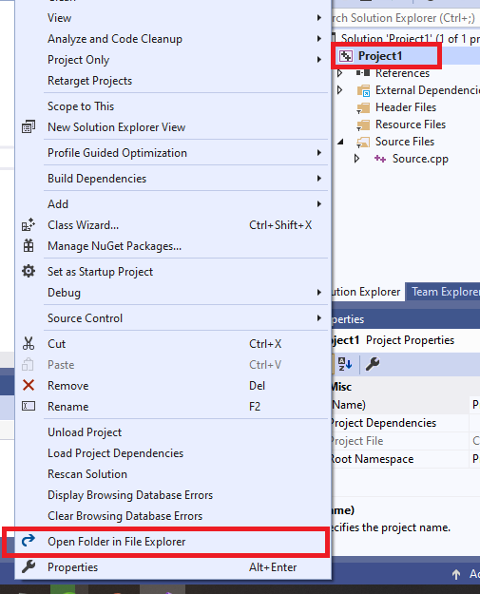
ifstream in( "clients.txt", ios::in );
Here you specify the path of file! i.e. path of location where the file resides
If no path is specified, instead only file name I written, then the compiler assumes that the file resides in your current project directory (folder where your C++ current project is created on disk)
See this figure to open that folder. Right click on Project and then choose “Open Folder in File Explorer” from the drop down menu

Slide 10
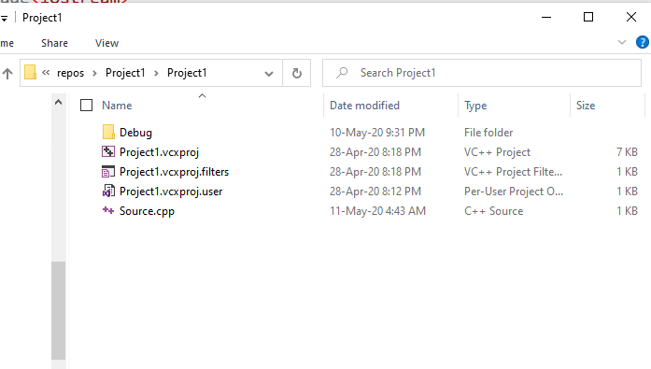

Slide 11
Closing a file
It is mandatory and preferred to ALWAYS close a file after using it (either for Input or for Output)
outClientFile.close();
#include<iostream>
#include<fstream>
using namespace std;
int main()
{
ofstream out("clients.txt", ios::out| ios::app);
out.close();
return 0;
}

Slide 12
Open function
We just covered how to open a file for I/O
The method that we covered is called “constructor method”
There is also another way to open a file. That is done using open function..

Slide 13
Open a file using open function
Same as:
#include<iostream>
#include<fstream>
using namespace std;
int main()
{
ofstream out("clients.txt", ios::out| ios::app);
out.close();
return 0;
}
#include<iostream>
#include<fstream>
using namespace std;
int main()
{
ofstream out;
out.open("clients.txt", ios::out | ios::app);
out.close();
return 0;
}
Same goes for opening a file for input!

Slide 14
Agenda
Read from a file
Write to a file

Slide 15
Default modes for ifstream,ofstream,fstream
What if we don’t specify the second parameter while opening a file

Slide 16
Each one of the open() member functions of the classes ofstream, ifstream and fstream has a default mode that is used if the file is opened without a second argument: ofstream ios::out ifstream ios::in fstream ios::in | ios::out

Slide 17
Read from file

Slide 18
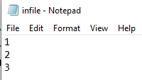
Read from the file
The file is organized in memory as a sequence (stream) of bytes!
1 | \n | 2 | \n | 3 | EoF | ..
0501 | 0502 | 0503 | 0504 | 0505 | 0506 | ..
File pointer

Slide 19
Read from the file
q1
q2
q3
1
0500
G
0340
G
1020
#include<iostream>
#include<fstream>
using namespace std;
int main()
{
int q1, q2, q3;
fstream f;
f.open("infile.txt");
f >> q1; // just like how cin is used to read
// a number from the keyboard
f >> q2;
f >> q3;
cout << q1 << " " << q2 << " " << q3 << endl;
f.close();
}
File pointer
EOF
Character read from file and then cout to the screent
There is always a file pointer associated with the file.
This pointer points at the start of the first initially.
Once we read a character, the file pointer moves one character ahead automatically.

Slide 20
Contd
q1
q2
q3
1
0500
2
0340
G
1020
#include<iostream>
#include<fstream>
using namespace std;
int main()
{
int q1, q2, q3;
fstream f;
f.open("infile.txt");
f >> q1; // just like how cin is used to read
// a number from the keyboard
f >> q2;
f >> q3;
cout << q1 << " " << q2 << " " << q3 << endl;
f.close();
}
File pointer
EOF
Character read from file and then cout to the screent
Just like in cin, filestream also takes space and newline as a terminating character..

Slide 21
Contd
q1
q2
q3
1
0500
2
0340
3
1020
#include<iostream>
#include<fstream>
using namespace std;
int main()
{
int q1, q2, q3;
fstream f;
f.open("infile.txt");
f >> q1; // just like how cin is used to read
// a number from the keyboard
f >> q2;
f >> q3;
cout << q1 << " " << q2 << " " << q3 << endl;
f.close();
}
EOF
File pointer
Character read from file and then cout to the screent
Just like in cin, filestream also takes space and newline as a terminating character..

Slide 22

Contd
#include<iostream>
#include<fstream>
using namespace std;
int main()
{
int q1, q2, q3;
fstream f;
f.open("infile.txt");
f >> q1; // just like how cin is used to read
// a number from the keyboard
f >> q2;
f >> q3;
cout << q1 << " " << q2 << " " << q3 << endl;
f.close();
}
EOF
File pointer
Just like in cin, filestream also takes space and newline as a terminating character..

Slide 23
Write to a file

Slide 24
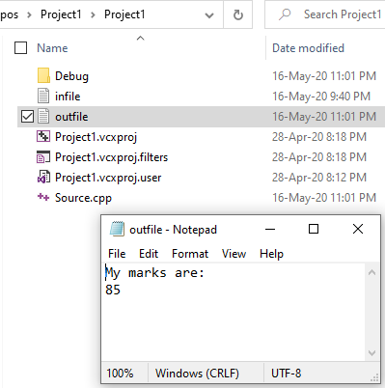
#include<iostream>
#include<fstream>
using namespace std;
int main()
{
int marks=85;
fstream f;
f.open("outfile.txt",ios::out);
f <<"My marks are:"; // just like how cout is used to write
// a number to the console
f << endl;
f << marks;
f.close();
}
Sometimes fstream wont create an output file without second argument. Therefore, it is ideal to always mention mode
EOF
File pointer

Slide 25
Append to the same file

Slide 26
File pointer

Slide 27
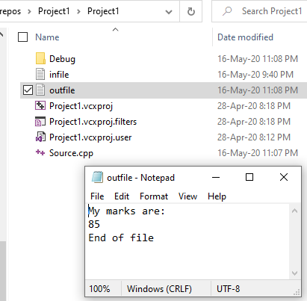
#include<iostream>
#include<fstream>
using namespace std;
int main()
{
int marks=85;
fstream f;
f.open("outfile.txt",ios::app);
f << endl;
f << "End of file";
f.close();
}
Location of pointer before appending
Location of pointer after appending

Slide 28
Read/write from file
Reads three numbers from the file, sums the numbers, and writes the sum to the file outfile.txt

Slide 29
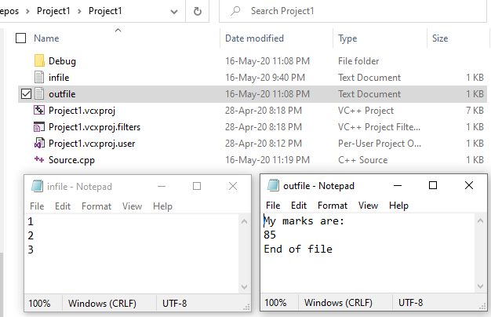

Slide 30
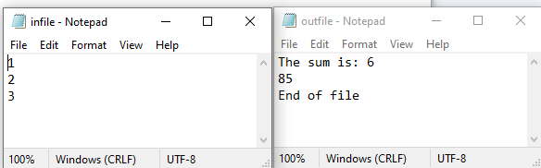
#include<iostream>
#include<fstream>
using namespace std;
int main()
{
fstream f1,f2;
f1.open("infile.txt",ios::in|ios::out);
f2.open("outfile.txt", ios::in | ios::out);
int first, second, third;
f1 >> first >> second >> third;
f2 << "The sum is: " << (first + second + third)
<< endl;
f1.close();
f2.close();
}

Slide 31
What if we open fstream with both in and out mode
The fstream object is associated with the operation that is performed first!

Slide 32
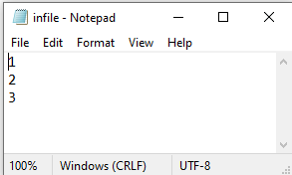
Input is performed first, (then you cannot perform output with this object afterwards)
Pointer points at the start for reading data
#include<iostream>
#include<fstream>
using namespace std;
int main()
{
fstream f1, f2;
f1.open("infile.txt", ios::in | ios::out);
int first, second, third;
f1 >> first >> second >> third;
cout << first << second << third << endl;
f1 << "Finished reading data";
f1.close();
}

Slide 33
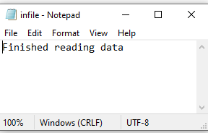
Output is performed first, (then you cannot perform input with this object afterwards~it wont work as required!)
#include<iostream>
#include<fstream>
using namespace std;
int main()
{
fstream f1, f2;
f1.open("infile.txt", ios::in | ios::out);
int first, second, third;
f1 << "Finished reading data";
f1 >> first >> second >> third;
cout << first << second << third << endl;
f1.close();
}
Pointer points at the start for writing the data, in truncate mode by default!

Slide 34
Read and write (truncate mode) on same file with different objects

Slide 35
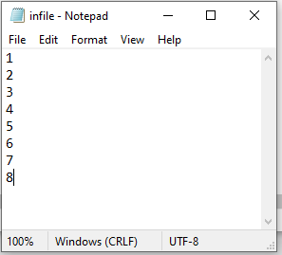

Slide 36
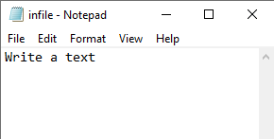

#include<iostream>
#include<fstream>
using namespace std;
int main()
{
fstream f1, f2;
f1.open("infile.txt", ios::in);
int first, second, third;
f1 >> first >> second >> third;
cout << first << second << third << endl;
f1.close();
f2.open("infile.txt", ios::out);
f2 << "Write a text" << endl;
f2.close();
}
Read first three bytes
File pointer
Write to console
Open the same file in truncate mode, reset the pointer, and write text

Slide 37
Read and write (append mode) on same file with different objects

Slide 39
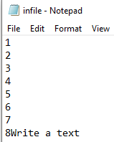
#include<iostream>
#include<fstream>
using namespace std;
int main()
{
fstream f1, f2;
f1.open("infile.txt", ios::in);
int first, second, third;
f1 >> first >> second >> third;
cout << first << second << third << endl;
f1.close();
f2.open("infile.txt", ios::app);
f2 << "Write a text" << endl;
f2.close();
}
Read first three bytes
File pointer
EOF
Open the same file in append mode, point the pointer to EoF, and write text
Write to console

Slide 40
Some useful functions related files

Slide 41
Check if file exists (before reading)
#include<iostream>
#include<fstream>
using namespace std;
int main(void)
{
int data;
ifstream fin; // declare stream variable name
fin.open("aa.txt", ios::in); // open file
if (fin.fail())
{
//File does not exist code here
}
else
{
}
fin.close(); //close file
return 0;
}
Fail() returns true if no file exists!
False, otherwise

Slide 42
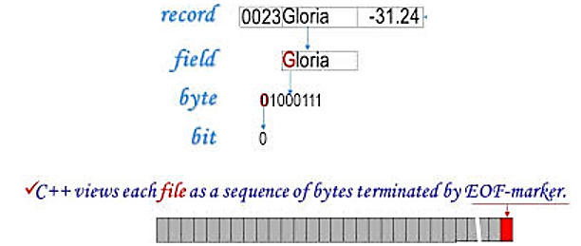
EOF character
C++ provides a special function, eof( ), that returns nonzero (meaning TRUE) when there are no more data to be read from an input file stream, and zero (meaning FALSE) otherwise.
eof() tests whether the "end of file" flag is set on the C++ stream object.
Before you attempt a read on an empty file the flag is not set.
You have to perform an operation that will try to read something before the flag will be set
For example, consider the following example in which we attempt to read from an empty file file.txt. But, as the eof flag is not set therefore the control moves inside while loop!
int data=0;
ifstream fin;
fin.open("file1.txt", ios::in);
while (!fin.eof())
{
fin >> data;
}

Slide 43
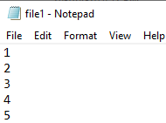
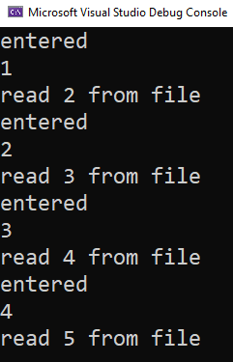
int data=0;
ifstream fin;
fin.open("file1.txt", ios::in); // open file
if (fin.fail()) {}
else
{
fin >> data;
while (!fin.eof()) //if not at end of file, continue reading numbers
{
cout << "entered " << endl;
cout << data << endl; //print numbers to screen
fin >> data; //get next number from file
cout << "read " << data << " from file" << endl;
}
}
fin.close(); //close file
Fail() check for existence of file
eof() checks if the file is empty

Slide 44
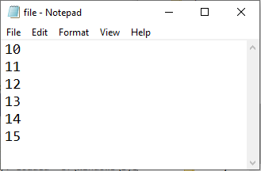
Write to a file based on some condition!
#include<iostream>
#include<fstream>
using namespace std;
int main(void)
{
int data=10;
fstream f;
f.open("file.txt", ios::out); // open file
while(data!=16)
{
f << data<<endl;
data++;
}
f.close(); //close file
return 0;
}

Slide 45
Some content for extra practice

Slide 46
Binary file
A binary file is a type of computer file that is used to store binary data.
It is used directly by the computer and generally can't be read by a human.
Suppose we wanted to store the number 4,000,000,000 (4 billion). As humans, we would write it as 4000000000, or 10 ASCII characters (10 bytes). How would a computer do it?
A single byte has 8 bits, or 2^8 (256) possible values. 4 bytes gives us 2^32 bits, or roughly 4 billion values. So, we could store the number 4 billion in only 4 bytes.
As you can see, storing numeric data in the computer’s format saves space. It also saves computational effort — the computer does not have to convert a number between binary and ASCII.
You can write a few numbers to disk using formatted I/O, but if you’re storing a large amount of numerical data it’s more efficient to use binary I/O, in which numbers are stored as they are in the computer’s RAM memory, rather than as strings of characters.

Slide 47
Summary
Why binary files?
Input and output are much faster using binary data. Converting a 32-bit integer to characters takes time. If a file (such as an image file) contains millions of numbers the accumulated conversion time is significant. Computer games would slow to a crawl if their data were stored in character form.
A binary file is usually very much smaller than a text file that contains an equivalent amount of data. For image, video, and audio data this is important. Small files save storage space, can be transmitted faster, and are processed faster. I/O with smaller files is faster, too, since there are fewer bytes to move.
Example of binary files: .exe

Slide 48
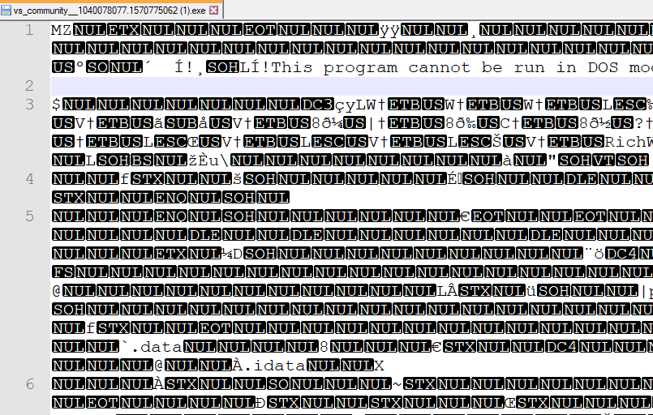
What if we open an exe file in notepad or any text editor?
Exe is not text.
It includes characters quite a lot of characters within non human-readable range
Say 0x0000_0000 is a code that your processor understands as an ADD instruction (reality is little complex than this, but very similar). Assume ADD is the first instruction in your exe. Now first 4 bytes of your exe file will have this data 0x0000_0000.

Slide 49
Binary vs text files
All files are binary; the data within them is a binary representation of some information.
If you have to store a large amount of text then the file will contain the binary representation of that text.
The difference between a "binary file" and a "text file" is that creating the latter involves converting data to a text form before saving it. This is typically done so humans can read it.

Slide 50
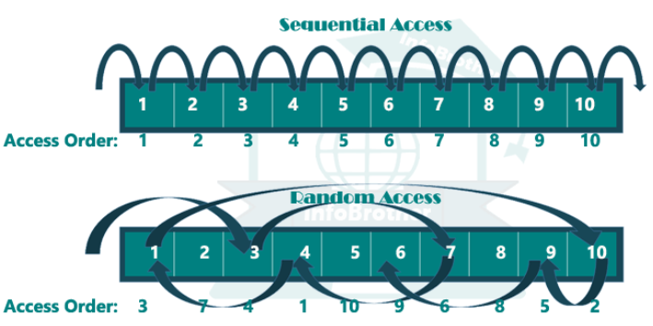
Sequential vs random access

Slide 51
File pointers (separate pointers for read and write)

Slide 52
Streams and pointers associated with them
For filestreams, there is a joint pointer that works for both input/output (moving one will automatically move the other one)
For stringstream, there is a separate pointer for read and write operation
Lets go through each..

Slide 53
Random access
Random access treats file as a big array.
We can read from anywhere and write to anywhere in the file
File pointer is involved to allow random access.
Each file has two pointers: input and output pointer
A joint file position is maintained for both the input sequence and the output sequence.
So, seekg and seekp are interchangeable for file streams. However, this is not true for other types of streams (e.g stringstream), as they may hold separate pointers for the put and get positions.
seekg() and tellg() functions are for input streams (ifstream) and seekp() and tellp() functions are for output streams (ofstream).
The tellg() function returns the current position of the get pointer

Slide 54
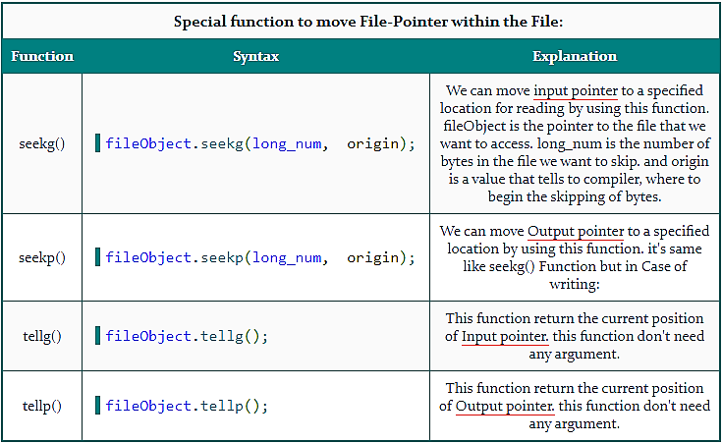

Slide 55
File streams and random access

Slide 56
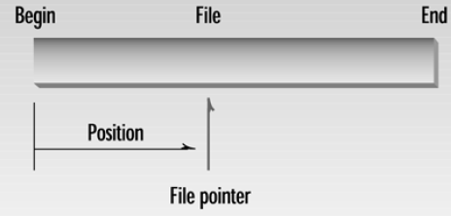
Seekg function’s form 1: seekg(long);
it moves the get_pointer or put_pointer to an absolute position.
ifstream fin;
ofstream fout;
// file opening routine
fin.seekg(30); // will move the get_pointer (in ifstream) to byte number 30 in the file
fout.seekp(30); // will move the put_pointer (in ofstream) to byte number 30 in the file

Slide 57
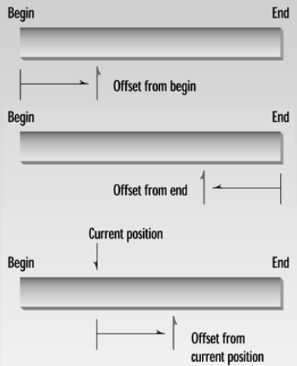
Seekg form 2: seekg(offset, origin);
Offset is the number of bytes that you want to skip
Origin is the value from where we want to start the skipping. There are three possibilities for it:
Ios::beg is the beginning of the file,
Ios::cur is the current pointer position, and
Ios::end is the end of the file.
5
-5
5

Slide 58


IOS::BEG
fstream file;
file.open(“file1.txt", ios::out);
file << “BSEF19M001";
cout << "Current position is: " << file.tellp() << endl;
file.seekp(6, ios::beg);
file << "A";
file.close();
0 | 1 | 2 | 3 | 4 | 5 | 6 | 7 | 8 | 9 | 10
B | S | E | F | 1 | 9 | A | 0 | 0 | 1 | EOF
0501 | 0502 | 0503 | 0504 | 0505 | 0506 | ..
File pointer

Slide 59


IOS::CUR
fstream file;
file.open(“file1.txt", ios::out);
file << "BSEF19M002";
cout << "Current position is: " << file.tellp() << endl;
file.seekp(3, ios::cur);
file << "BSEF19A002";
file.close();
0 | 1 | 2 | 3 | 4 | 5 | 6 | 7 | 8 | 9 | 10
B | S | E | F | 1 | 9 | M | 0 | 0 | 2 | EOF
0501 | 0502 | 0503 | 0504 | 0505 | 0506 | ..
File pointer
0 | 1 | 2 | 3 | 4 | 5 | 6 | 7 | 8 | 9 | 10 | 11 | 12 | 13 | 14 | 15 | 16 | 17 | 18 | 19 | 20 | 21 | 22 | 23
B | S | E | F | 1 | 9 | M | 0 | 0 | 2 |  |  |  | B | S | E | F | 1 | 9 | A | 0 | 0 | 2 | EOF
01 | 02 | 03 | 04 | 05 | 06 | .. | ..
Current position
Skipping 3 bytes starting from the current position

Slide 60
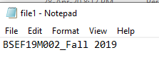
IOS::END (offset must be a negative value! Because from end we always have to move backward!)
fstream file;
file.open(“file1.txt", ios::out);
file << "BSEF19M002_*";
file.seekg(-1, ios::end);
file << "Fall 2019";
file.close();
Start printing text
from here
Because of -1 move backward one step!
0 | 1 | 2 | 3 | 4 | 5 | 6 | 7 | 8 | 9 | 10 | 11 | 12 | 13 | 14 | 15 | 16 | 17 | 18 | 19 | 20 | 21 | 22 | 23
B | S | E | F | 1 | 9 | M | 0 | 0 | 2 | _ | * | EOF
01 | 02 | 03 | 04 | 05 | 06 | .. | ..
end position
0 | 1 | 2 | 3 | 4 | 5 | 6 | 7 | 8 | 9 | 10 | 11 | 12 | 13 | 14 | 15 | 16 | 17 | 18 | 19 | 20 | 21 | 22 | 23
B | S | E | F | 1 | 9 | M | 0 | 0 | 2 | _ | F | a | l | l |  | 2 | 0 | 1 | 9 | EOF
01 | 02 | 03 | 04 | 05 | 06 | .. | ..

Slide 61
Why stringstreams are useful?
As we discussed that filestream treats both get and put pointer jointly, therefore we will not be able to see the effect of get and put pointer separately
E.g. when we will move get pointer, then put pointer will also get moved automatically!
Therefore, to realize the advantages of get and put pointers, we will see how to use them with string stream!
String stream is a stream (method for dealing with files) that is extremely useful for parsing input file and using get/put pointer for random access

Slide 62
String stream
Stream is a sequence of bytes.
A stringstream associates a string object with a stream allowing you to read from the string as if it were a stream (like cin)
We have to include <sstream> library

Slide 63
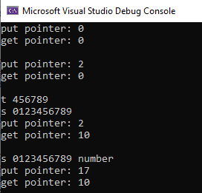
String stream: example
std::stringstream s("0123456789");
std::cout << "put pointer: " << s.tellp() << std::endl;
std::cout << "get pointer: " << s.tellg() << std::endl;
std::cout << std::endl;
s.seekp(2);
string t,t1;
std::cout << "put pointer: " << s.tellp() << std::endl;
std::cout << "get pointer: " << s.tellg() << std::endl;
std::cout << std::endl;
s.seekg(4);
s >> t;
cout <<"t "<< t << endl;
cout << "s " << s.str() << endl;
s.clear();
std::cout << "put pointer: " << s.tellp() << std::endl;
std::cout << "get pointer: " << s.tellg() << std::endl;
std::cout << std::endl;
s.seekp(0, ios::end);
s << " number";
cout << "s " << s.str() << endl;
std::cout << "put pointer: " << s.tellp() << std::endl;
std::cout << "get pointer: " << s.tellg() << std::endl;
std::cout << std::endl;

Slide 64
String stream: example
std::stringstream s("0123456789");
std::cout << "put pointer: " << s.tellp() << std::endl;
std::cout << "get pointer: " << s.tellg() << std::endl;
std::cout << std::endl;

Slide 65
String stream: example
0 | 1 | 2 | 3 | 4 | 5 | 6 | 7 | 8 | 9 | 10
0 | 1 | 2 | 3 | 4 | 5 | 6 | 7 | 8 | 9 | EOF
0501 | 0502 | 0503 | 0504 | 0505 | 0506 | ..
s.seekp(2);
string t,t1;
std::cout << "put pointer: " << s.tellp() << std::endl;
std::cout << "get pointer: " << s.tellg() << std::endl;
std::cout << std::endl;
get
put

Slide 66
String stream: example
0 | 1 | 2 | 3 | 4 | 5 | 6 | 7 | 8 | 9 | 10
0 | 1 | 2 | 3 | 4 | 5 | 6 | 7 | 8 | 9 | EOF
0501 | 0502 | 0503 | 0504 | 0505 | 0506 | ..
put
get
s.seekg(4);
s >> t;
cout <<"t "<< t << endl;
cout << "s " << s.str() << endl;
0 | 1 | 2 | 3 | 4 | 5 | 6 | 7 | 8 | 9 | 10
0 | 1 | 2 | 3 | 4 | 5 | 6 | 7 | 8 | 9 | EOF
0501 | 0502 | 0503 | 0504 | 0505 | 0506 | ..
put
get

Slide 67
String stream: example
s.clear();
std::cout << "put pointer: " << s.tellp() << std::endl;
std::cout << "get pointer: " << s.tellg() << std::endl;
std::cout << std::endl;

Slide 68
String stream: example
0 | 1 | 2 | 3 | 4 | 5 | 6 | 7 | 8 | 9 | 10 | 11 | 12 | 13 | 14 | 15 | 16 | 17 | 18
0 | 1 | 2 | 3 | 4 | 5 | 6 | 7 | 8 | 9 |  | n | u | m | b | e | r | EOF
0501 | 0502 | 0503 | 0504 | 0505 | 0506 | ..
get
put
s.seekp(0, ios::end);
s << " number";
cout << "s " << s.str() << endl;
std::cout << "put pointer: " << s.tellp() << std::endl;
std::cout << "get pointer: " << s.tellg() << std::endl;
std::cout << std::endl;

Slide 69
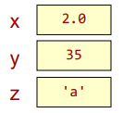
Usefulness
Used to easily parse input data
Can be used to parse input while file read/write operations
stringstream ss;
ss << "2.0 35 a";
double x, int y; char z;
ss >> x >> y >> z;

Slide 70

Convert stringstream to string
Use the .str() member function to create a large string from many value (i.e. return a string with the contents of whatever is in the stream)
#include using namespace std;
int main()
{
stringstream ss;
ss << 2.0 << " " << 35;
ss << " " << 'a’;
string s = ss.str();
return 0;
}

Slide 71
Parse input: convert from string to other data type
string text;
int num;
double val;
stringstream ss("Hello 103 2.0");
ss >> text >> num >> val;

Slide 72
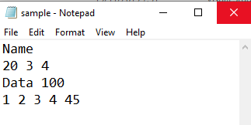
Parse input: when there are varying number of elements on each line
fstream myfile; int total_words = 0; int num_lines = 0;
myfile.open("sample.txt", ios::in);
string str;
while (getline(myfile, str))
{
stringstream ss(str);
string word;
while (ss >> word)
{
total_words++;
}
num_lines++;
}
cout << total_words << endl;
cout << num_lines << endl;
myfile.close();

Slide 73

Parse input: extract words that are delimited by comma
fstream myfile; int total_words = 0; int num_lines = 0;
myfile.open("sample.txt", ios::in);
string input = "abc,def,ghi";
stringstream ss(input);
string token;
while (getline(ss, token, ','))
{
cout << token << endl;
}
myfile.close();

Slide 74
End

